Slide 1
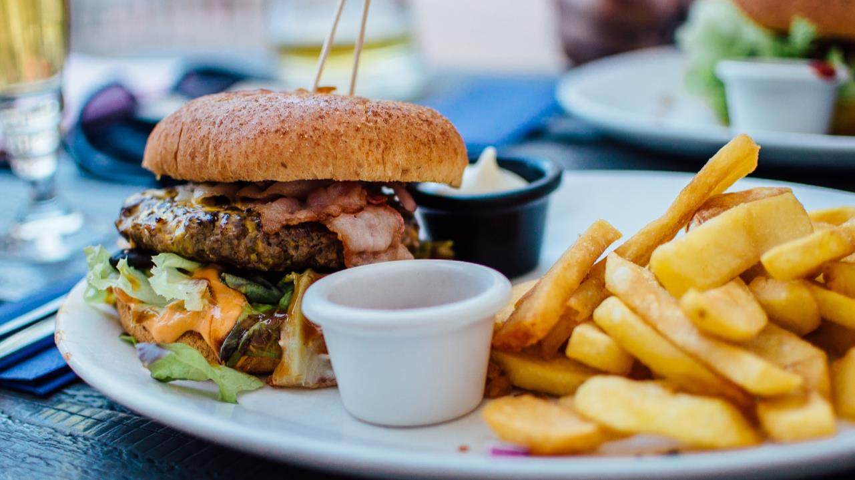
Burger Heaven Case Study
Mock Analysis
March 11, 2019
By: Julia Yeung

Slide 2
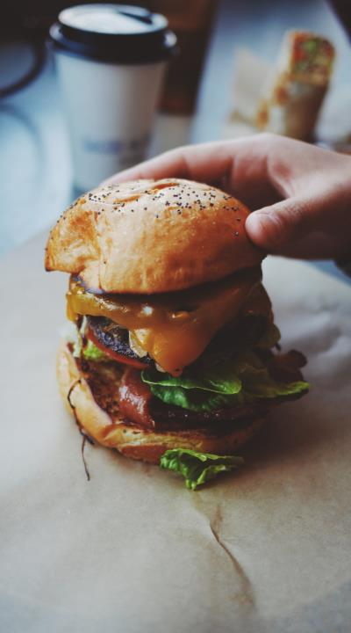
Burger Heaven Case Study Question
Which were the most/least effective campaigns and why?
2

Slide 3
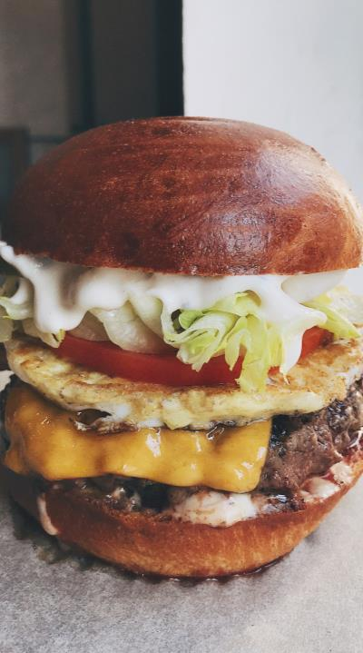

Grouped Element:
Frame, TM statement, color overlay
Placement:
Snap into place (covers the left side of the slide)
Through data analysis and reviewing brand memorability results of each campaign, it is found:
Most Effective Campaigns = Movie Tie-in #3, Burger #1, Breakfast Sandwich #2
Least Effective Campaigns = Open Late #2, Burger #4, Burger #7
Brand memorability is a strong indicator of a campaign’s success based on combined:
Ability to recall the ad watched during a program
Ability to recall the brand of the ad involved
CAMPAIGNS

Slide 4

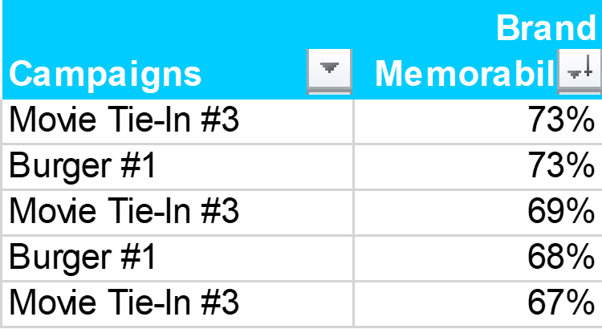
Reasoning of Results for Most Effective Campaigns
Through the data set provided on excel, the 5 highest percentages of brand memorability results were determined
Results – Most Effective
4

Slide 5
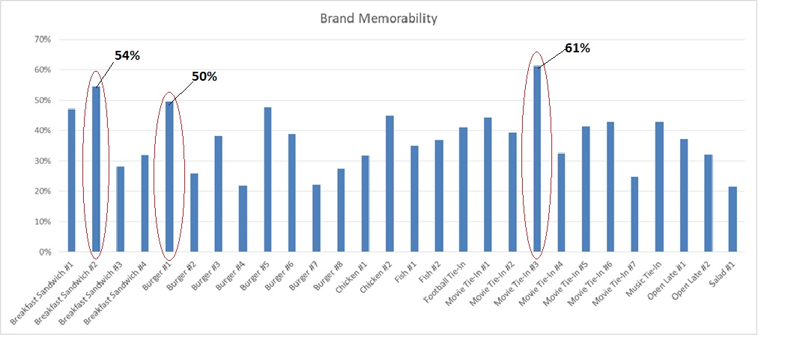
Brand Memorability – Based on Campaign Averages

Slide 6
Reasoning of Results for Most Effective Campaigns (cont.)
Results – Most Effective
1. Top 5 Highest Percentages in Brand Memorability: Both Movie Tie-In #3 and Burger #1 showed up multiple times as the top 5 highest percentages in brand memorability from all campaigns ran for Burger Heaven.
2. Campaign Averages of Brand Memorability: The averages of each campaign’s brand memorability is also important to determine the effect of the campaign for the brand as a whole. This leads to Movie Tie-In #3 with 61%, Breakfast Sandwich #2 with 54%, and Burger #1 with 50% as the highest leading averages.
6

Slide 7
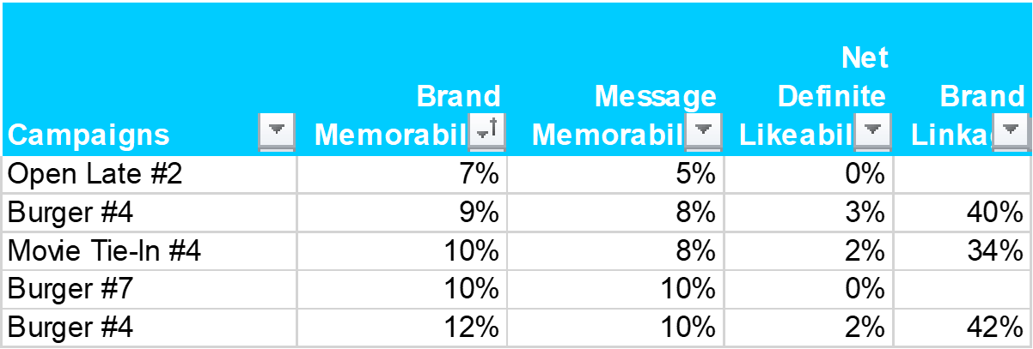
Grouped Element:
Frame, TM statement, color overlay
Placement:
Snap into place (covers the left side of the slide)
Reasoning of Results for Least Effective Campaigns
Results –
Least Effective
Through the data set provided on excel, the 5 lowest percentages of brand memorability results were determined

Slide 8
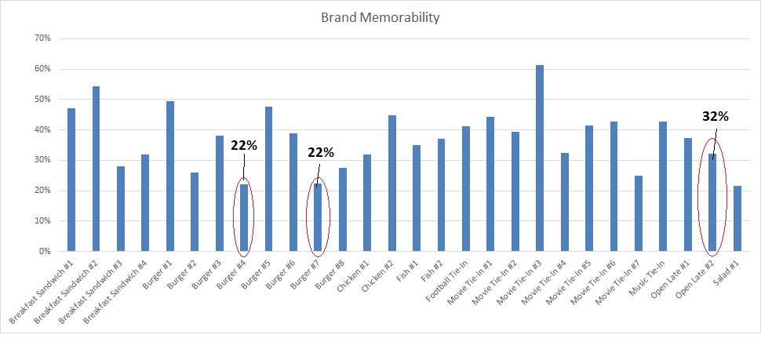
Brand Memorability – Based on Campaign Averages

Slide 9
Reasoning of Results for Least Effective Campaigns (cont.)
1. Lowest 5 Percentages in Brand Memorability: Open Late #2, Burger #4, and Burger #7 showed as having the lowest results for brand memorability. These campaigns also have the some of the lowest results for message memorability and net definite likeability. This indicates that there is a low chance for people to remember the brand and message of the ad shown. There is also the factor that the ad is not appealing to people since the likability factor is also very low.
2. Campaign Averages of Brand Memorability: Burger #4 and Burger #7 showed up as having one of the lowest averages for brand memorability out of all the campaigns with only 22%.
3. Brand Linkage: Both Open Late #2 and Burger #7 do not show any indication of people being able to link the ad to the brand, which means an ineffective ad campaign for Burger Heaven.
Results –
Least Effective
9

Slide 10
Grouped Element:
Frame, TM statement, color overlay
Placement:
Snap into place (covers the left side of the slide)
Burger Heaven Case Study Question
2. What else should this advertiser be told based on the data?

Slide 11
Further Insights
According to the data set, the use of icon “Heaven” in Burger Heaven’s campaign is strongly connected with the brand. The data shows that people tend to link the icon, perhaps due to its name relation, to the brand more than other icons used. It is suggested that future campaigns include the use of this icon to build further brand connection to Burger Heaven.
Data Insights
11

Slide 12
Further Insights
Based on the data, Burger Heaven’s campaigns are also effective when using the “Ducks” icon in their advertising. The high ad memorability percentage indicates that the use of ducks help people remember the ad more and has a higher possibility of remembering the brand with it as well.
Data Insights
12

Slide 13
Further Insights
Data Insights
Based on the data, it shows that the lack of an icon makes the message of the ad unclear and difficult for viewers to understand the purpose of the commercial. The icon should also match the message of the ad.
For example, “Fashion Designer” icon for the Salad #1 campaign seems to be ineffective because it was not connected to the message the ad was trying to send to viewers.
It is strongly suggested that the brand includes icons into their future campaigns that match the message of the ad, such as the strong results with the “Ducks” and “Heaven” icons.
Copyright © Phoenix Marketing International 2018. All rights reserved.

Slide 14
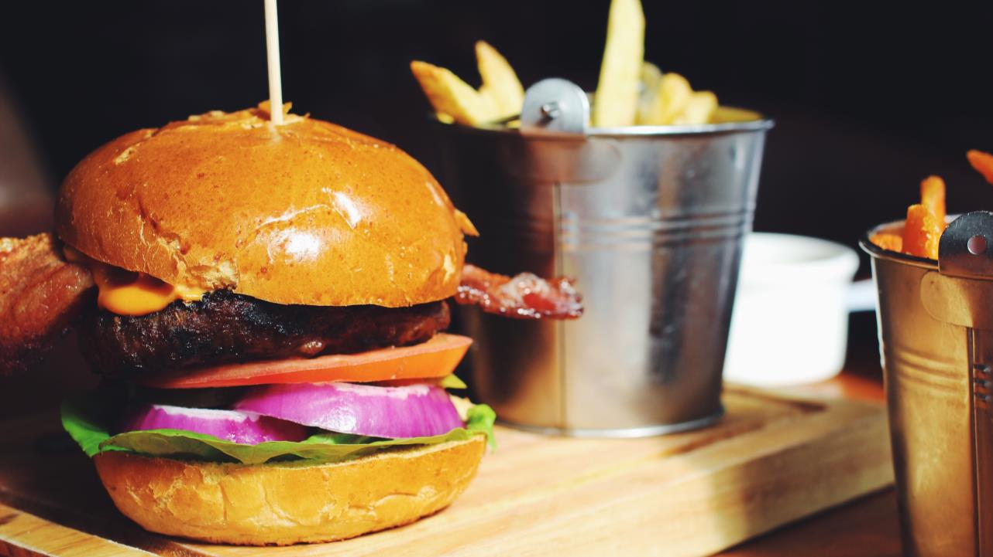
Grouped Element:
Frame, TM statement, small logo + slide number, color overlay
Placement:
Snap into place (covers the entire slide)

